Slide 1

Car Repair and Maintenance App
Presented By
Ahmad Mustafa
Muhammad Munawar Khan

Slide 2
Problem Statement
Car owners often forget routine maintenance tasks, which can lead to vehicle
damage and costly repairs.
There is no simple way to track service history and monitor the health of multiple
vehicles.
A lack of timely reminders and proper records results in poor vehicle performance and
reduced lifespan.

Slide 3
Introduction
The Car Repair and Maintenance App is designed to help users take care of their vehicles in a simple and easy way. It keeps a record of all past services and repairs, reminds users about upcoming maintenance tasks, and allows them to check the health of each car. This app is designed specially for car owners. By keeping track of everything in one place, it helps increase the life of the vehicle, reduce repair costs, and make car maintenance more organized and stress-free.

Slide 4
Software Requirement Specifications
Functionals Requirements
Users can add multiple cars and save details like model, year, license plate, and VIN.
Users can enter car health information (engine, tires, fluids, brakes, etc.).
Users can log odometer readings and keep track of them with dates.
The app records fuel and service costs and calculates:
Cost per kilometer
Fuel efficiency
Users can set maintenance reminders and get notifications when they are due.
The app shows health alerts and classifies them as critical or warning.
Admins can view the user list and deactivate accounts when needed.

Slide 5
Software Requirement Specifications
Non-Functionals Requirements
REQ-1: The app should work smoothly even with 1000 or more records.
REQ-2: Users should be able to back up their data manually to keep it safe.
REQ-3: The app should be easy to use, have a simple design, and be reliable for storing data..
REQ-4: Only the user who owns the car data can edit it, and every change needs confirmation before saving.
REQ-5: The app should open quickly and respond fast when users add or view information.

Slide 6
Software Requirement Specifications
Constraints
All user data (car info, login details, etc.) must be encrypted when stored or sent, to keep it
safe.
The interface must be responsive (adjust to different screen sizes) and easy to use for all
types of users.
Any updates to the app must not delete or break the existing user data.

Slide 7
Software Requirement Specifications
Parameters
Mileage (Odometer): Users enter how many km their car has driven
Car Health Info: Users add info about engine, tires, etc.
Reminders: Users set reminders based on date or distance.
Costs: Users enter fuel and service costs.

Slide 8
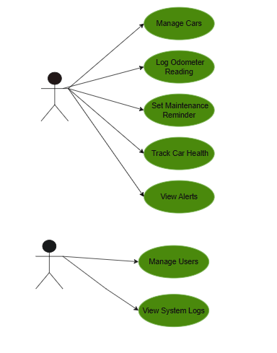
Software Requirement Specifications
Use Case Diagram
Actors
Car User
System Administrator
Use Cases
Manage Cars
Log Meter Reading
Set Maintenance Remainder
Track Car Health
View Alerts
Manage Users
View System Logs
Car User
Include
Cost Tracking
System Administrator

Slide 9
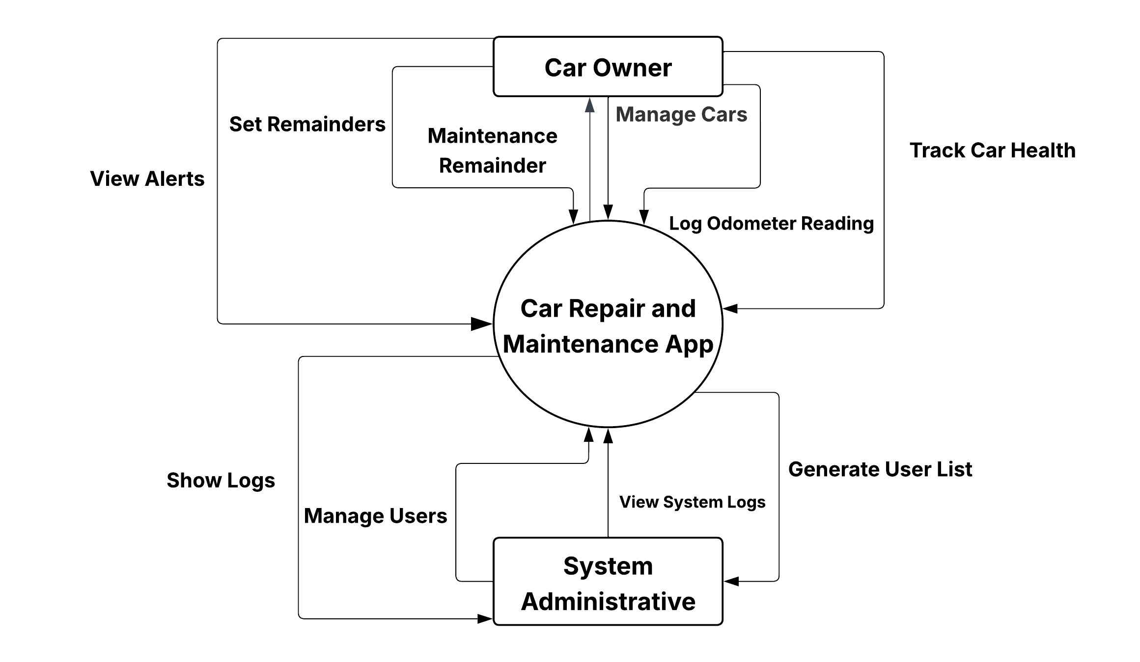
Software Requirement Specifications
DFD Level 0

Slide 10
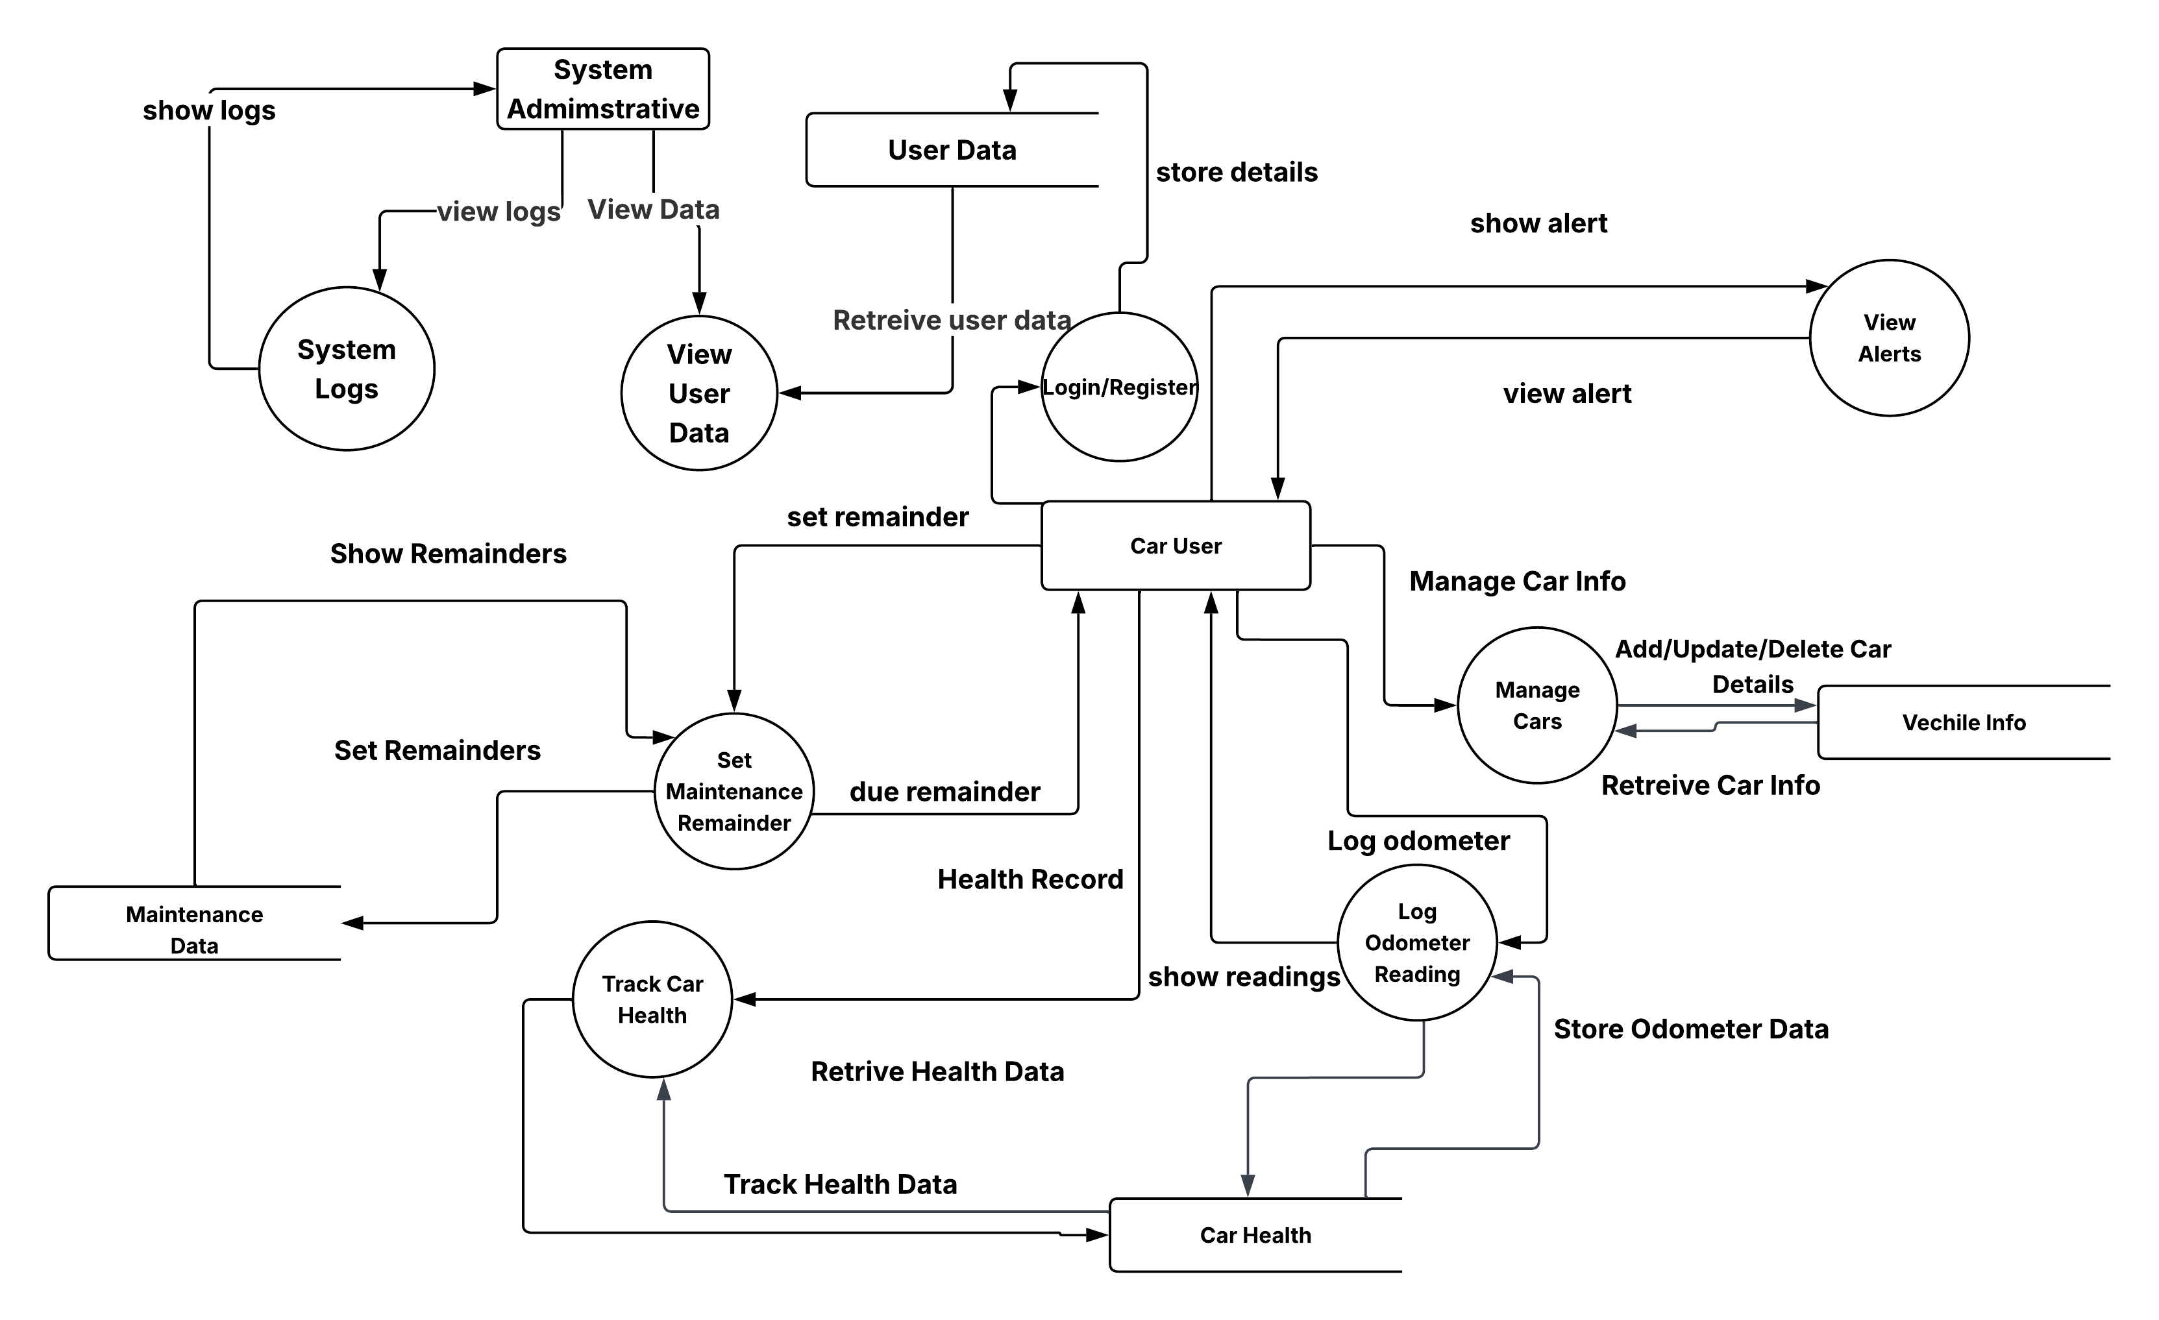
Software Requirement Specifications
DFD Level 1

Slide 11
Software Requirement Specifications
Use Case Description
Use Case: Manage Cars
Actors: Registered Car User
Description: The user adds, edits, views, or deletes their vehicle information.
Preconditions: User must be logged in.
Postconditions: Vehicle information is saved or updated in the database.
Basic Flow:
1. User navigates to the car management screen.
2. User selects add/edit/delete/view option.
3. User enters or updates vehicle details.
4. System stores the information.
Alternative Flows:
Invalid data entered → System shows error message.

Slide 12
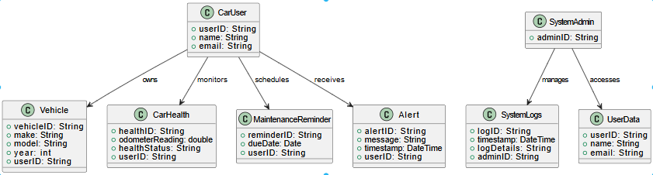
Detailed Design Document
Class Diagram

Slide 13
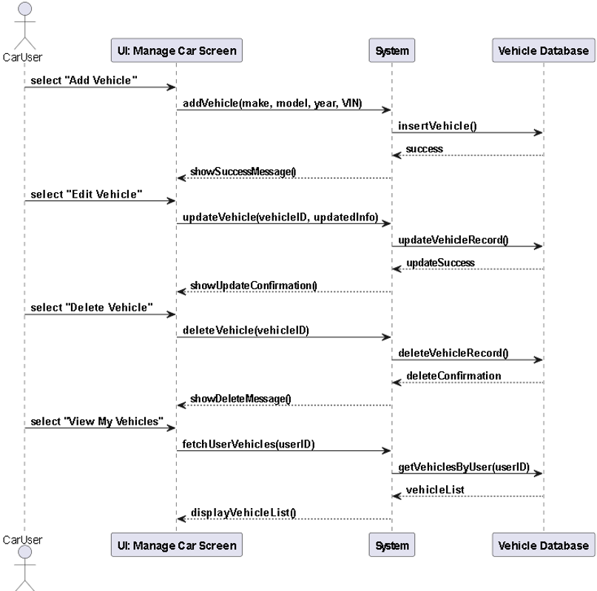
Detailed Design Document
System Sequence Diagram
Use Case: Manage Cars

Slide 14
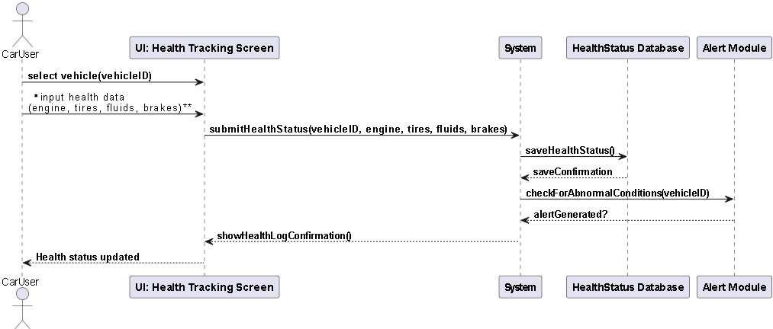
Detailed Design Document
System Sequence Diagram
Use Case: Track Car Health

Slide 15
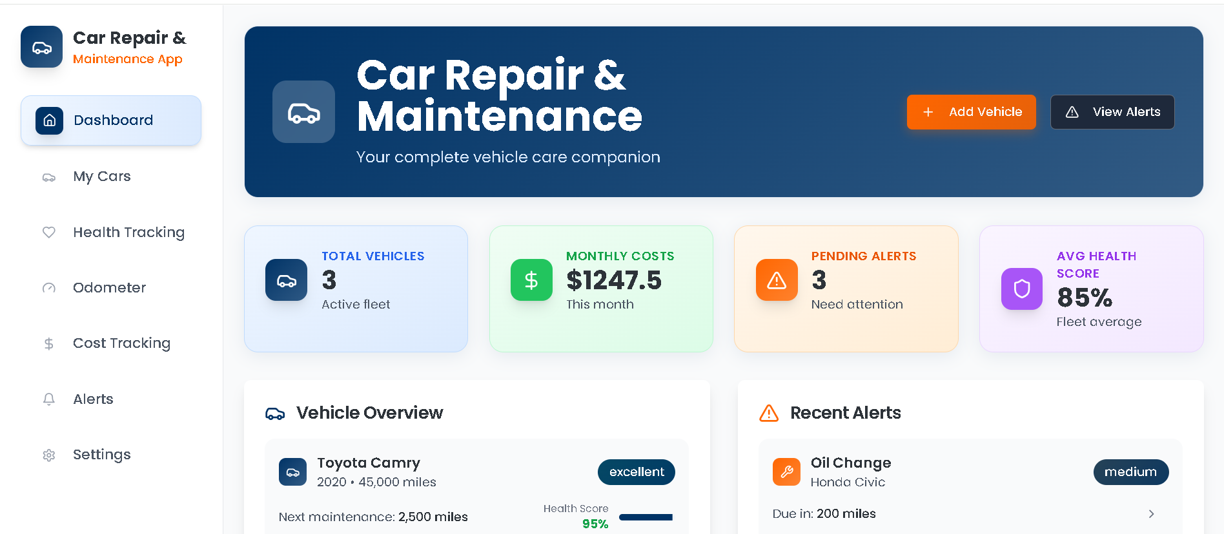
Detailed Design Document
Interface Design

Slide 16
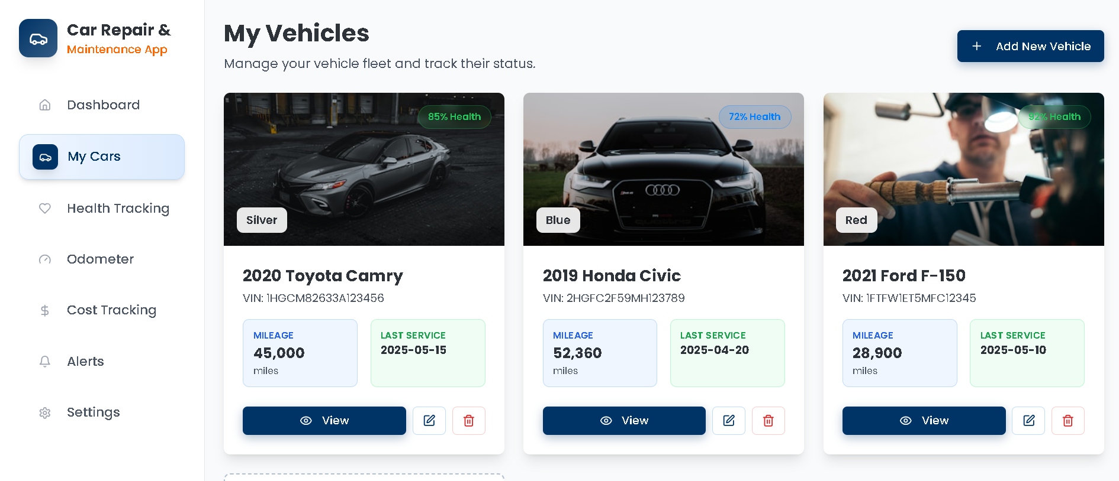
Detailed Design Document
Interface Design

Slide 17
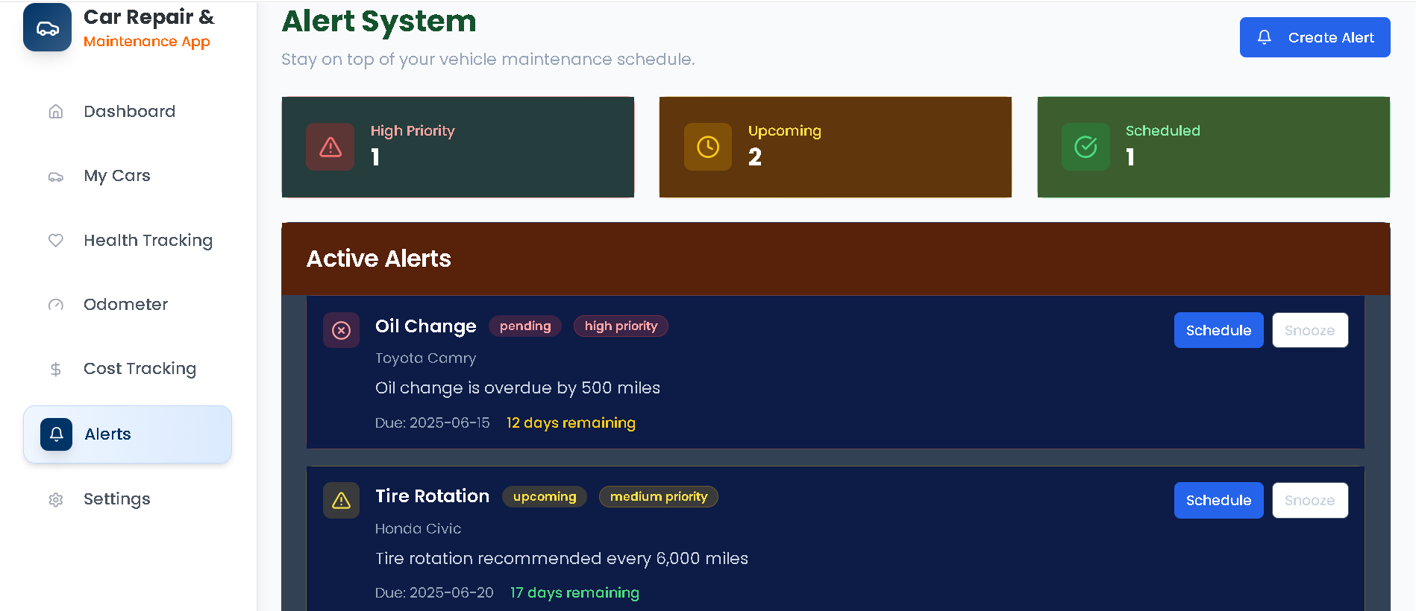
Detailed Design Document
Interface Design

Slide 18
Test Report
Test Types
UI Consistency: Layouts, icons, fonts are consistent
Responsiveness: Mobile and desktop views tested
Accessibility: Labels and contrasts verified
Form Usability: Inputs and error prompts validated
Navigation Flow: Clear transitions between screens
Use Case | Test Case IDs | Description | Coverage
Manage Cars | TC-UI-001 to TC-UI-005 | Add, Edit, Delete, View Cars | ✅ 100%
Track Car Health | TC-UI-006 to TC-UI-010 | Enter health indicators, view alerts | ✅ 100%

Slide 19
Test Report
Test Case ID | Module | Status | Notes
TC-UI-001 to TC-UI-002 | Manage Cars | ✅ Passed | Car list loads, Updating.
TC-UI-003 to TC-UI-004 | Manage Cars | ✅ Passed | Deletion confirms.
TC-UI-002 to TC-UI-005 | Track Car Health | ✅ Passed | Health input form working well
TC-UI-006 to TC-UI-009 | Track Car Health | ✅ Passed | Health Details Displayed(Tire pressure, Oil etc.).
Bugs
Bug ID | Module | Description | Severity | Status
BUG-001 | Track Car Health | Tire pressure allows unrealistic input (e.g. 150 psi) | Low | Not Reproduced
— | — | No major UI/UX bugs found | — | ✅ Closed

